Slide 1

Prepared by group 19
Daimond Clarity
Prediction
19CSE305-Machine Learning

Slide 2



Team Members
AMBATI REVANTH
SHAIK REHAAN ASHRAF
Y.PRASANNA REDDY
AM.EN.U4CSE22102
AM.EN.U4CSE22153
AM.EN.U4CSE22161

Slide 3
Motivation
The motivation behind this diamond clarity prediction project stems from the significant role that diamond clarity plays in determining a diamond's value and appeal. By accurately predicting diamond clarity, stakeholders in the diamond industry, such as jewelers, buyers, and graders, can:
Improve accuracy and efficiency in diamond grading.
Boost customer trust with consistent, transparent quality assessments.
Align pricing with predicted clarity for better valuation.
Minimize errors and subjectivity using automated models.

Slide 4
Problem Statement
Given a dataset of diamonds with various attributes (carat weight, price, cut, color, depth, etc.), design a machine learning model that accurately predicts the clarity grade of each diamond. The model's performance will be evaluated using accuracy and other relevant metrics to ensure reliable assessments of diamond quality.

Slide 5

Datasets
Dataset 3:
Shape: 26967 records with 11 attributes
Numerical Attributes: 7,
Catogerical Attributes: 3
No. of columns with missing data: 1
Dataset 1:
Shape: 53940 records with 10 attributes
Numerical Attributes: 8
Catogerical Attributes: 2
No. of columns with missing data: 0
Dataset 2:
Shape: 6000 records with 8 attributes
Numerical Attributes: 2
Catogerical Attributes: 6
No. of columns with missing data: 0

Slide 6

Models Utilized
RANDOM FOREST CLASSIFIER
Light Gradient Boosting Machine
Extreme Gradient Boosting

Slide 7
Data Preprocessing of Dataset 1

Slide 8
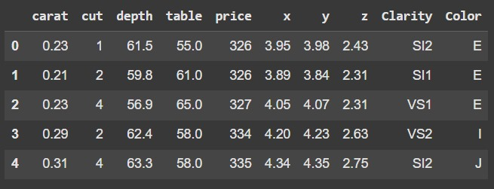
Dataset 1 view:

Slide 9
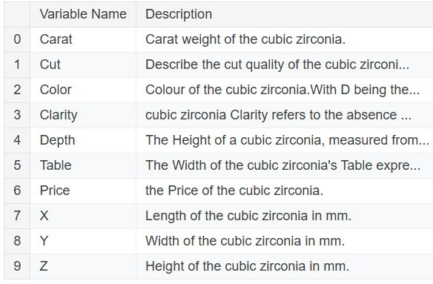

Slide 10
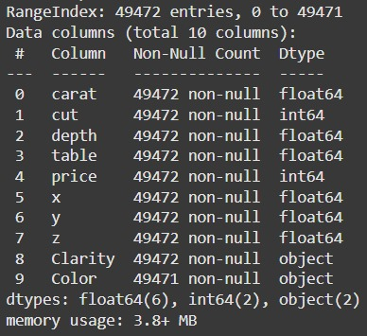
Understanding the
Dataset 1

Slide 11
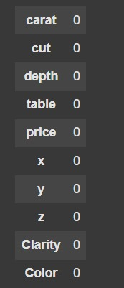
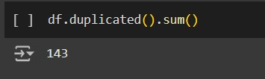
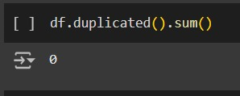
Deep Dive into Dataset 1
Missing Values
Duplicated Rows
Before Removing
After Removing

Slide 12
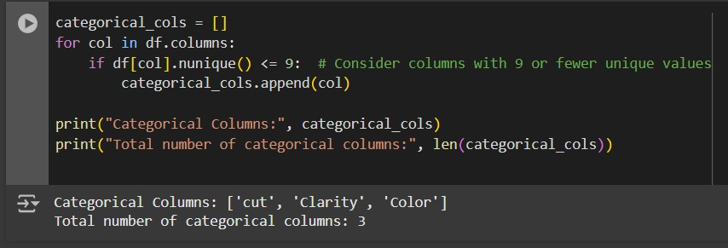
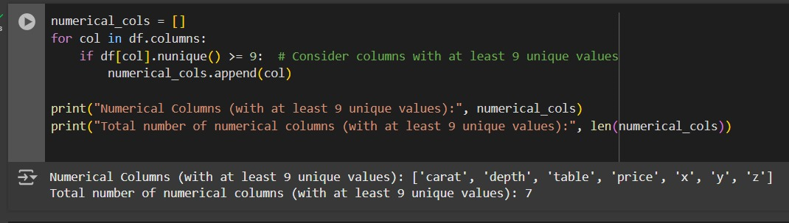
Deep Dive into Dataset 1
Categorial Values
Numerical Values

Slide 13
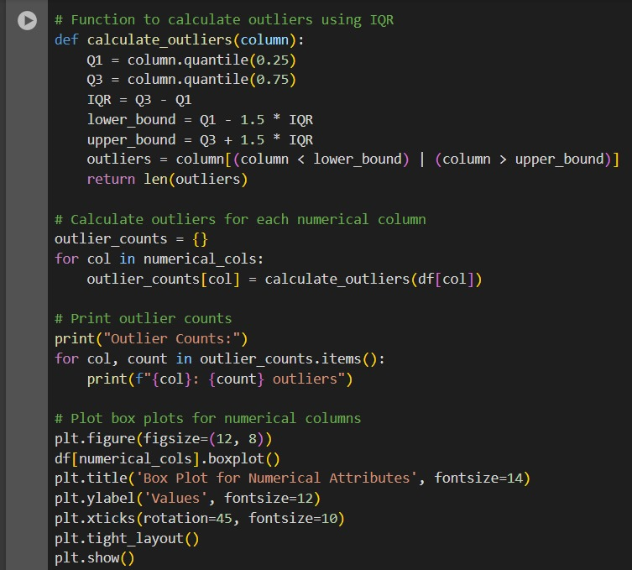
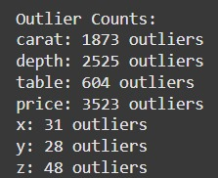
Outlier Detection in Dataset 1:

Slide 14
SMOTE
SMOTE (Synthetic Minority Over-sampling Technique) generates synthetic data points for the minority class by interpolating between existing minority class samples.
Benefits for our case:
Improves class balance: Helps address the class imbalance in the dataset.
Enhances model performance: Increases the model's ability to correctly classify minority class samples.
Reduces bias: Prevents overfitting and underperformance for minority classes, improving overall accuracy.

Slide 15
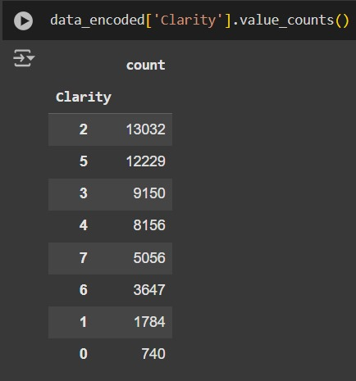
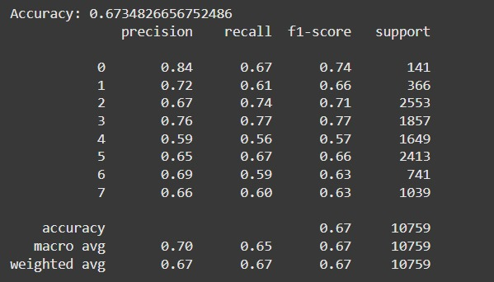
SMOTE of Dataset 1:
Before Smote
Accuracy

Slide 16
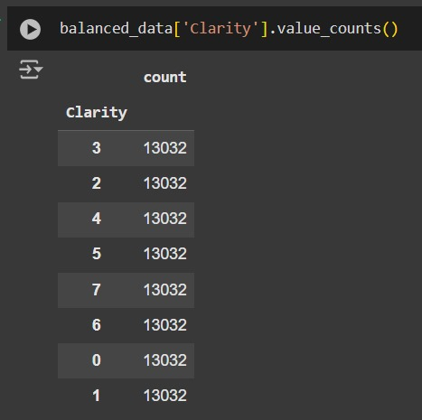
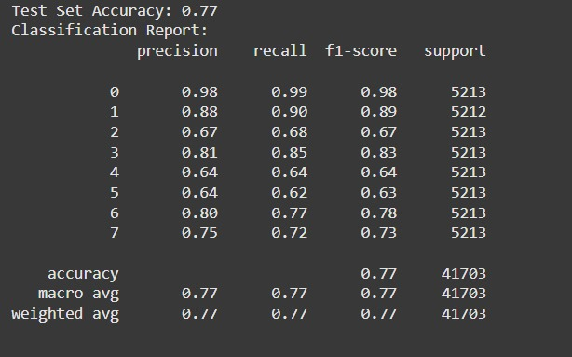
SMOTE of Dataset 1:
After Smote
Accuracy

Slide 17
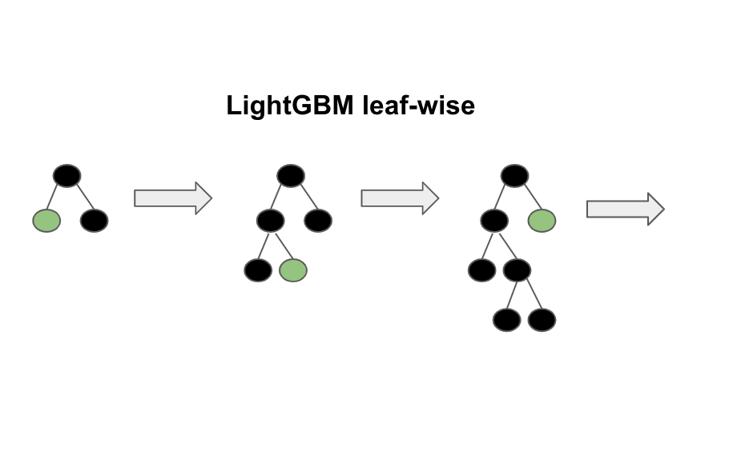
Light Gradient Boosting Machine

Slide 18
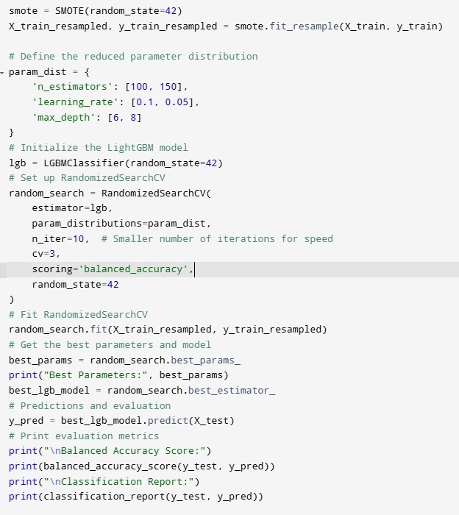
Model Training using LGBoost
Dataset 1:

Slide 19
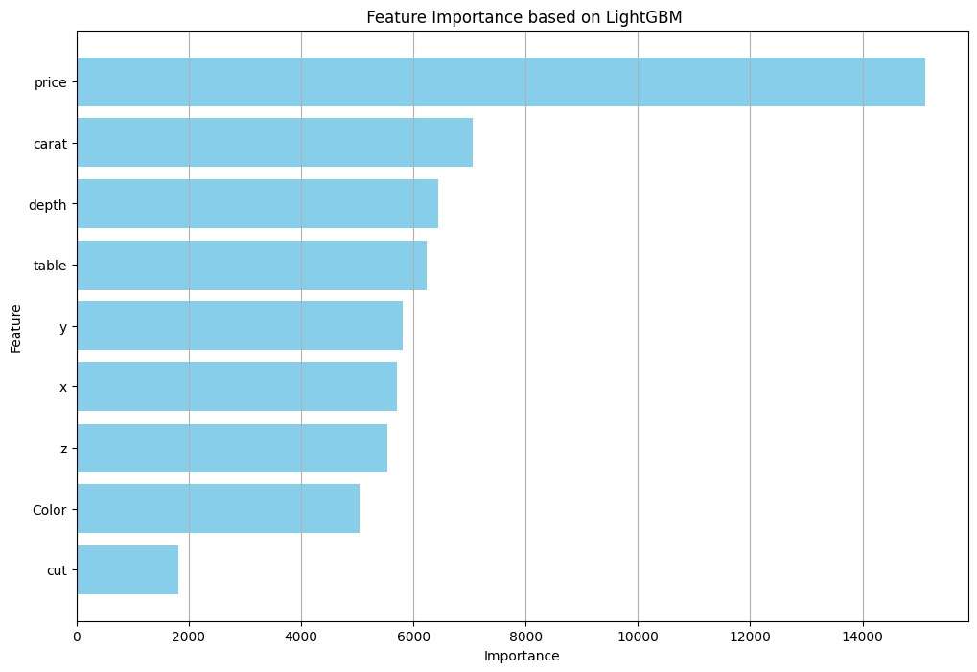
Dataset 1:
Feature Importance

Slide 20
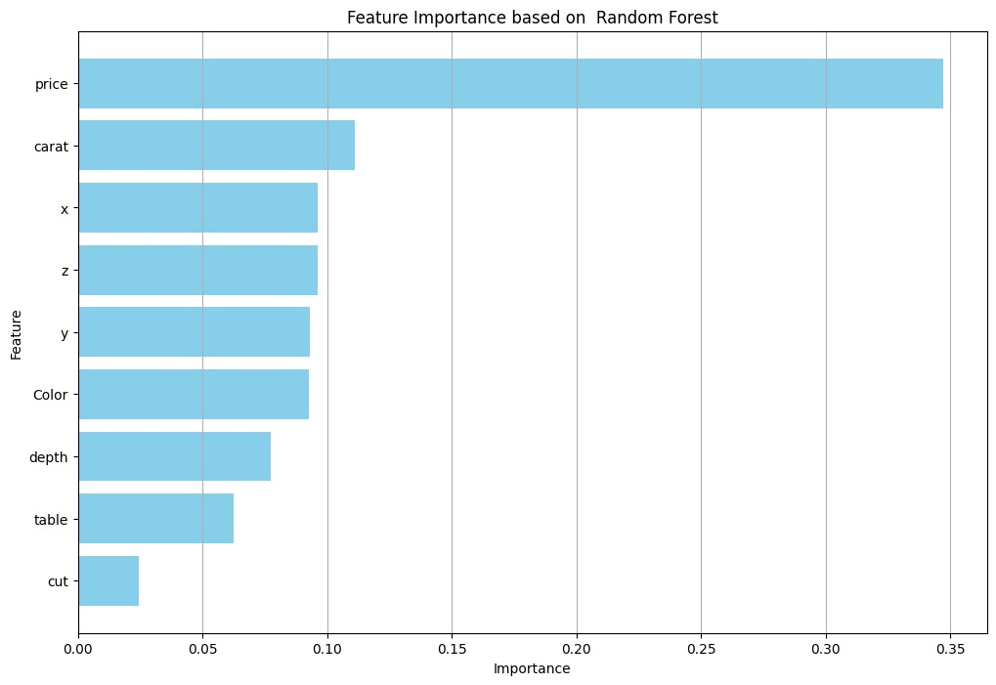
Dataset 1:
Feature Importance

Slide 21
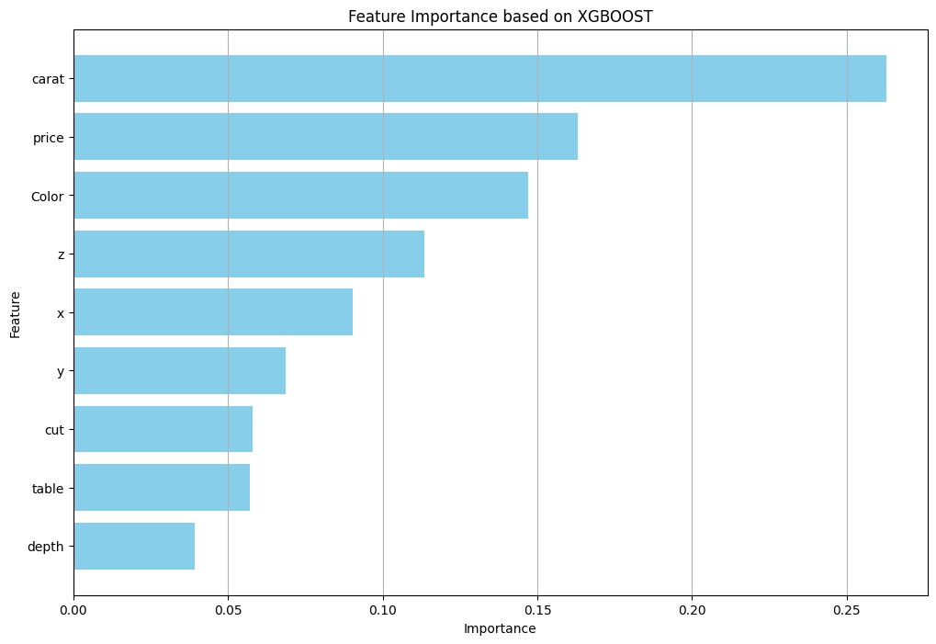
Dataset 1:
Feature Importance

Slide 22
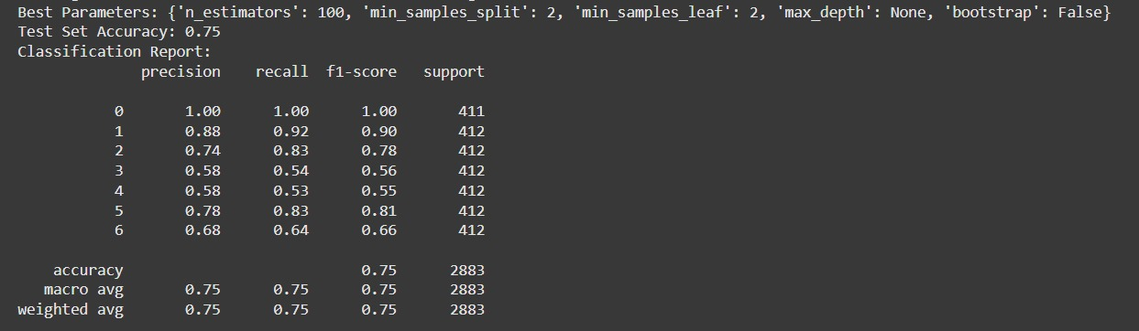
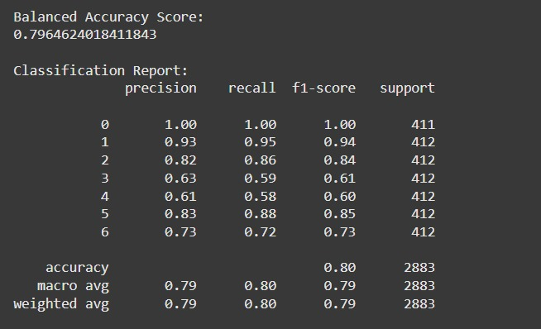
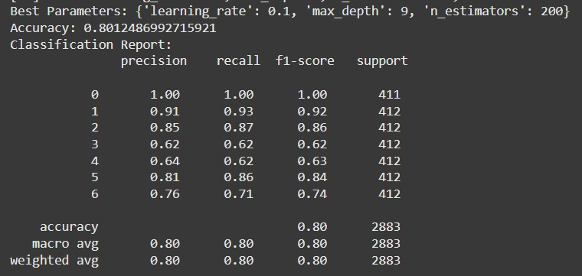
Random Forest
Dataset-1 Results :
Light GBM
XGBoost

Slide 23
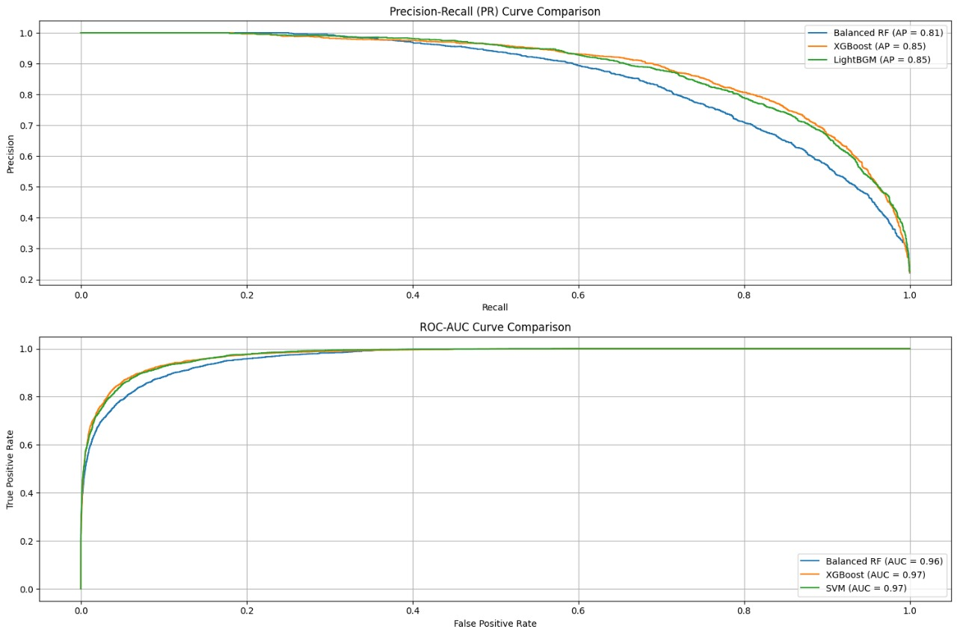
Dataset 1:
PR & ROC
Curve Comparision

Slide 24
Data Preprocessing of Dataset 2

Slide 25
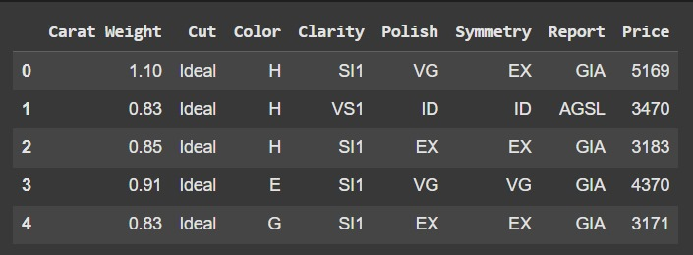
Dataset 2 view:

Slide 26
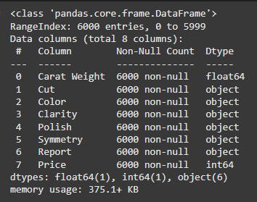
Understanding the
Dataset 2

Slide 27
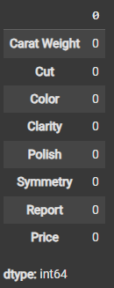
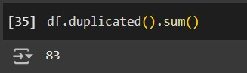
Deep Dive into Dataset 2
Duplicated Rows
Before Removing
Missing Values
After Removing

Slide 28
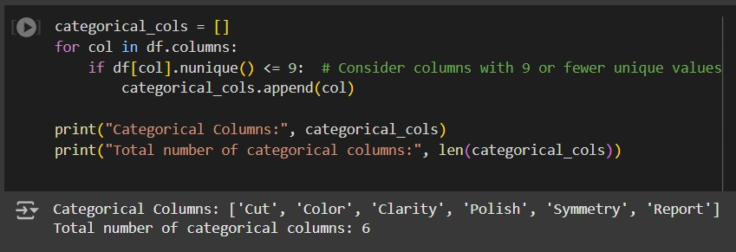
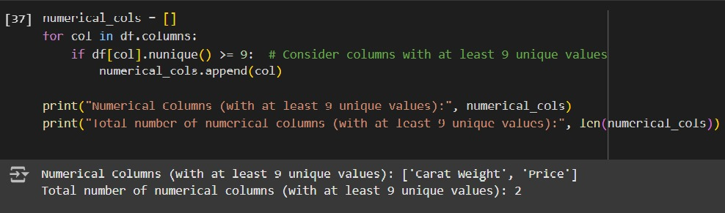
Deep Dive into Dataset 2
Categorial Values
Numerical Values

Slide 29
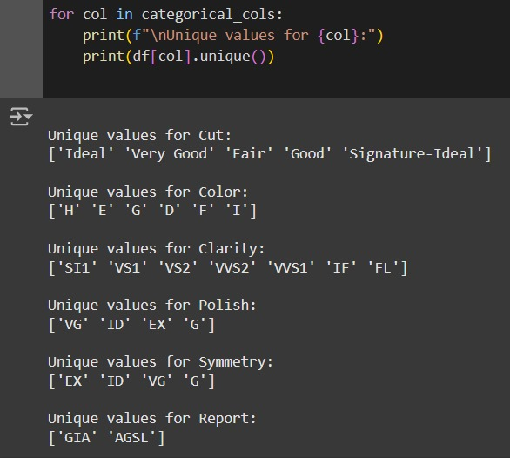
Categorial Values
29

Slide 30
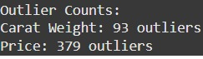
Outlier Detection in Dataset 2:

Slide 31
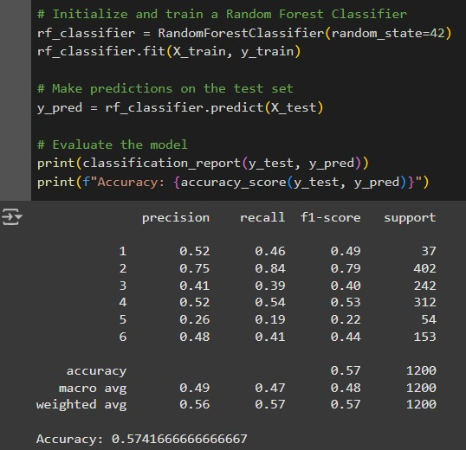
31

Slide 32
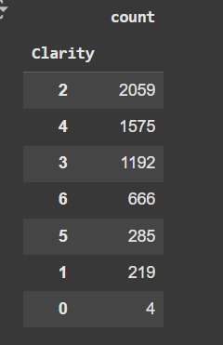
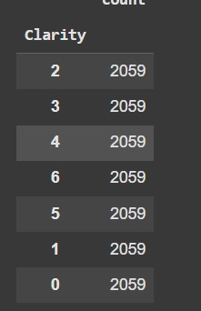
SMOTE of Dataset 2:
Before Smote
After Smote

Slide 33
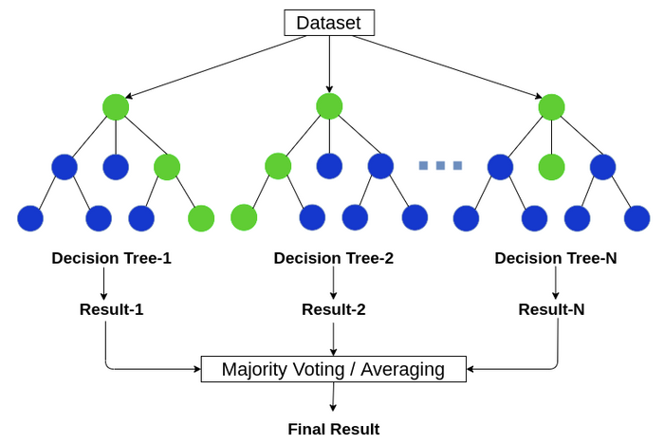
Random Forest

Slide 34
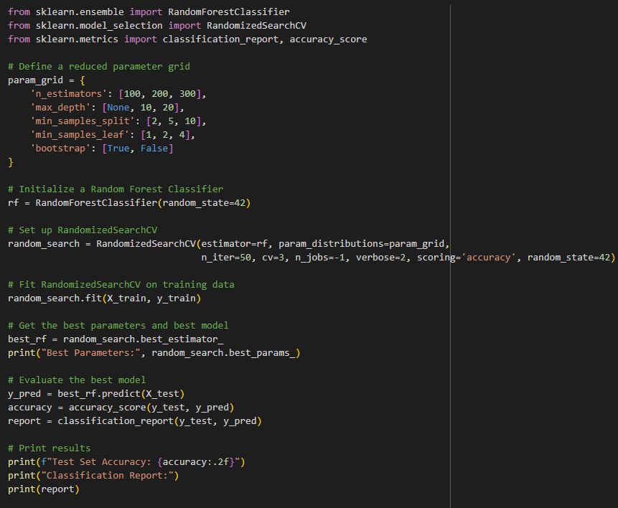
Model Training using Random Forest
Dataset 2:
Best Parameters: {'n_estimators': 100, 'min_samples_split': 2, 'min_samples_leaf': 2, 'max_depth': None, 'bootstrap': False}

Slide 35
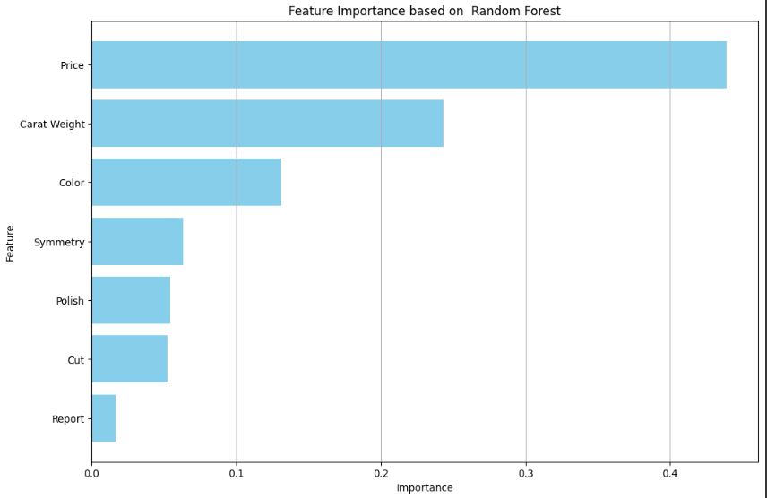
Dataset 2:
Feature Importance

Slide 36
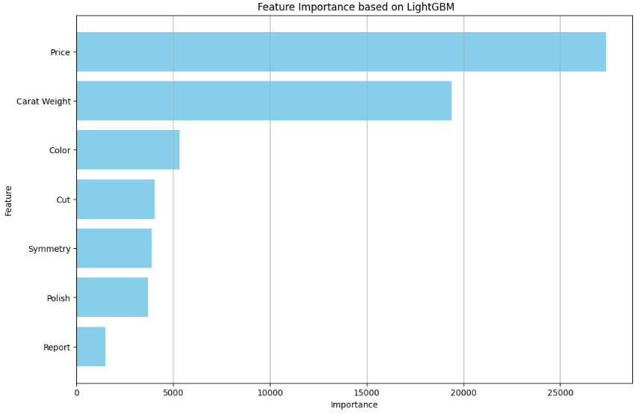
Dataset 2:
Feature Importance

Slide 37
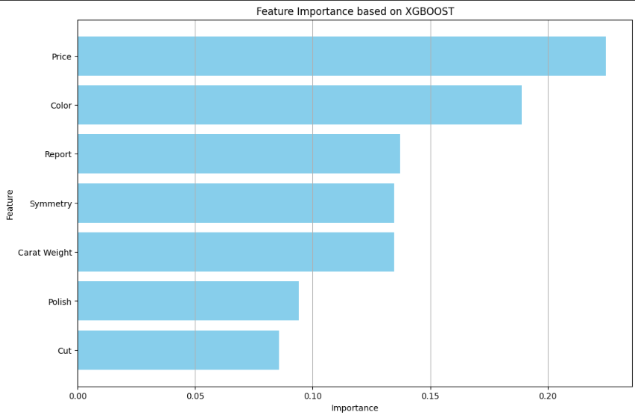
Dataset 2:
Feature Importance

Slide 38
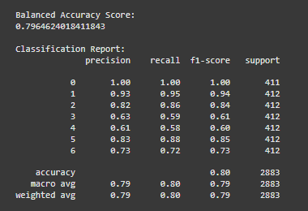
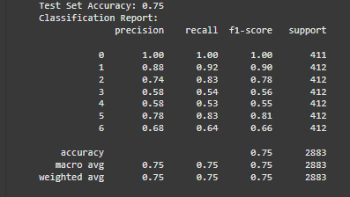
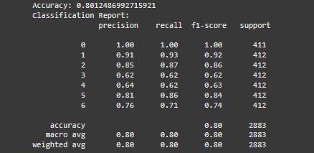
Dataset-2 Results :
Light GBM
Random Forest
XGBoost

Slide 39
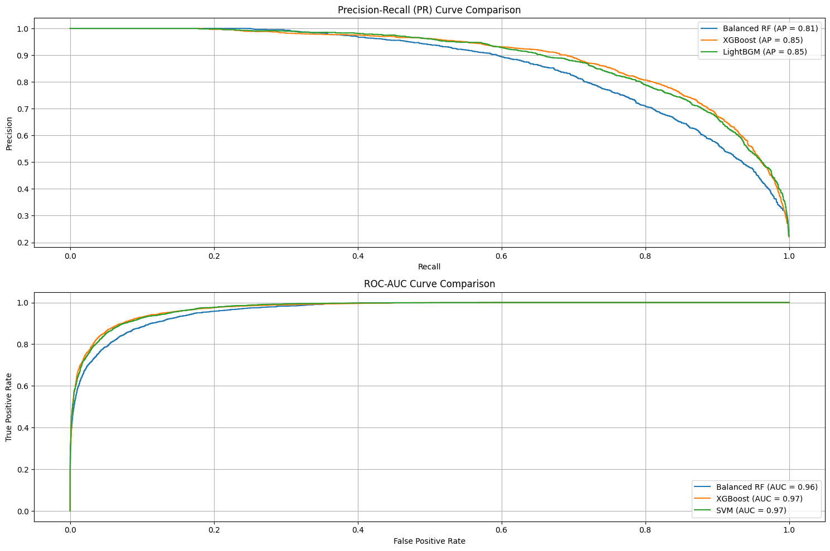
Dataset 2:
PR & ROC
Curve Comparision

Slide 40
Data Preprocessing of Dataset 3

Slide 41
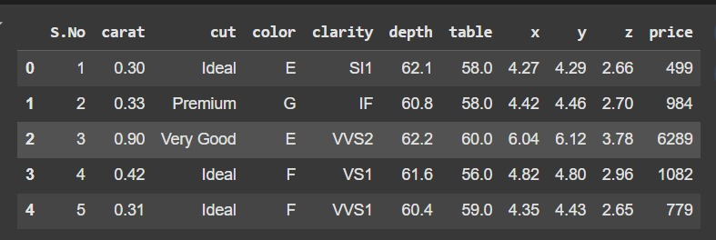
Dataset 3 view:

Slide 42
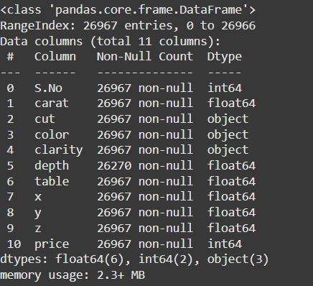
Understanding the
Dataset 3

Slide 43
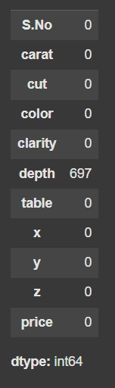
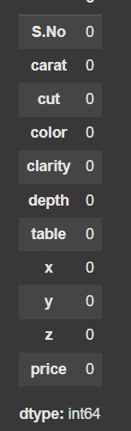
Deep Dive into Dataset 3
Missing Values
Before removing
After removing
Duplicated Rows

Slide 44
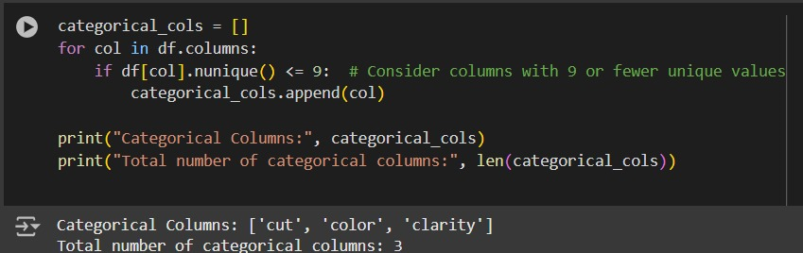
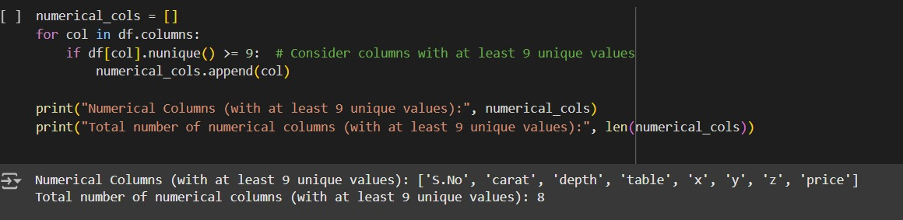
Deep Dive into Dataset 3
Categorial Values
Numerical Values

Slide 45
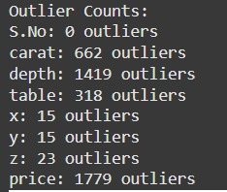
Outlier Detection in Dataset 3:

Slide 46


SMOTE of Dataset 3:
Before Smote
After Smote

Slide 47

Extreme Gradient Boost

Slide 48

Model Training using XGBoost
Dataset 3:

Slide 49

Dataset 3:
Feature Importance

Slide 50

Dataset 3:
Feature Importance

Slide 51

Dataset 3:
Feature Importance

Slide 52



Random Forest
Dataset-3 Results :
Light GBM
XGBoost

Slide 53

Dataset 3:
PR & ROC
Curve Comparision

Slide 54
Thank you

